Slide 1

How to Teach Students to Be A System Thinker
Jessica Li 2017
Notes:
1400

Slide 2
What is System?

Slide 3
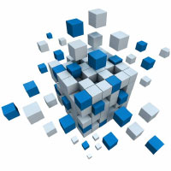

Slide 4


Slide 5
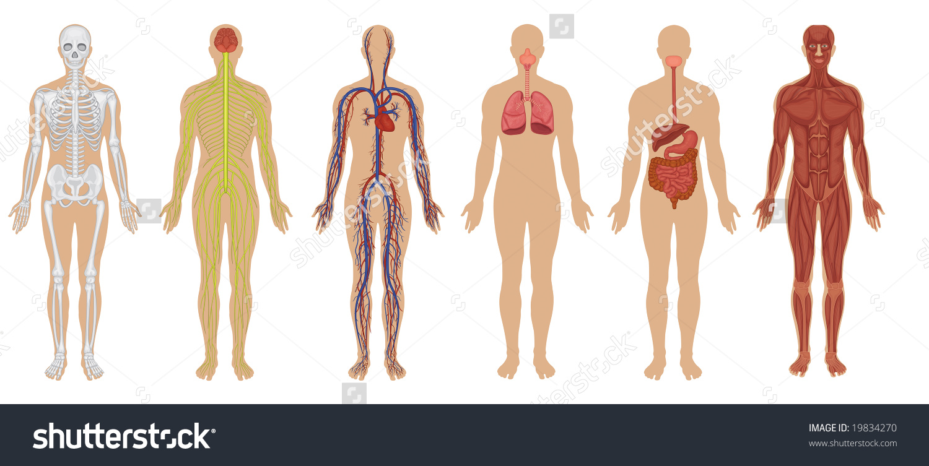

Slide 6


Slide 7
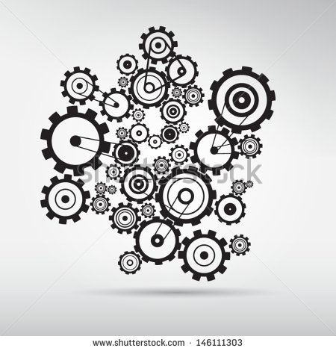
Notes:
1405

Slide 8
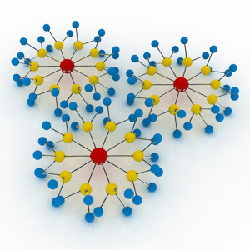
Components & connections
Notes:
1405-1407

Slide 9
System is composed of a chain of related components.
The whole can complete the task that can’t be done by individual components.
There are a set of rules to follow.
Notes:
1407-1410

Slide 10
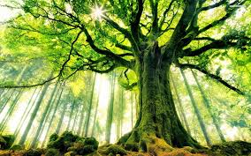
Discuss with your group members to name various systems in daily life.
Notes:
1410-1415 (2 for discussion and 3 mins for sharing)

Slide 11
What is System Thinking?

Slide 12
System thinking
Mental model
Team Learning
Shared vision
Personal mastery
The Fifth Discipline
By Peter Senge
Notes:
1415-1417

Slide 13
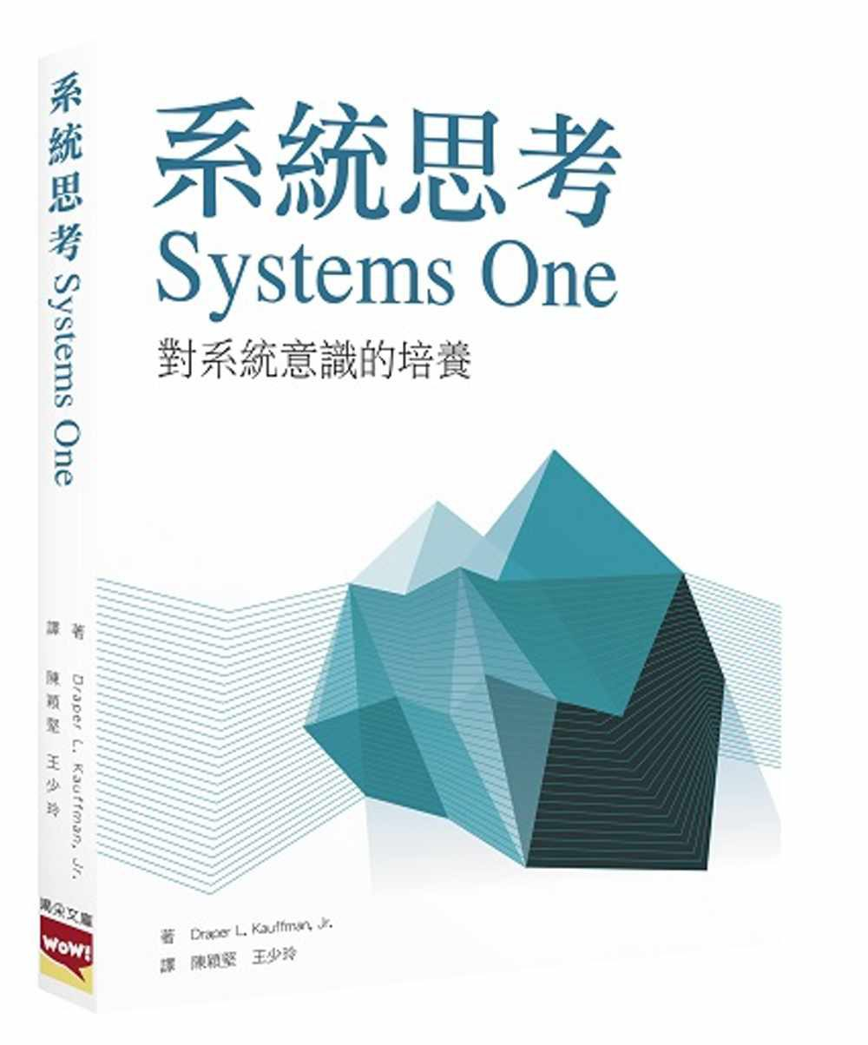
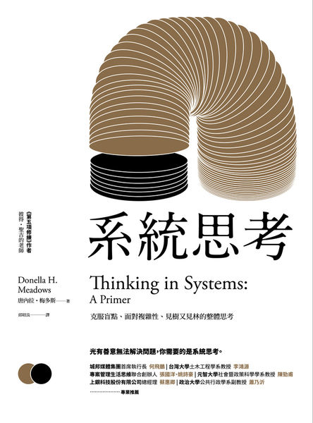
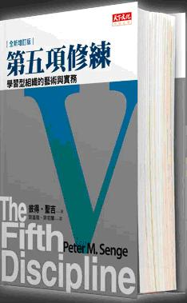
Notes:
1417-1419

Slide 14
Thinking about the whole instead of the parts.
Putting emphasis on the relationships between the different components
Taking into account the context, circumstances or environment .
Notes:
1419-1425

Slide 15
Two Concerns in System Thinking
Make use of Limited resources
Create the highest efficiency
Notes:
1425-1430

Slide 16

What kind of animal do these pictures indicate?

Slide 17


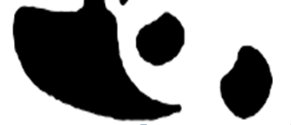
Think about the Whole
Notes:
1430-1432

Slide 18
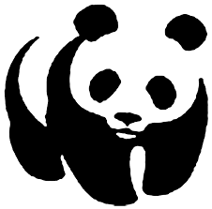
Is this your guessing?
Notes:
1432-1434

Slide 19
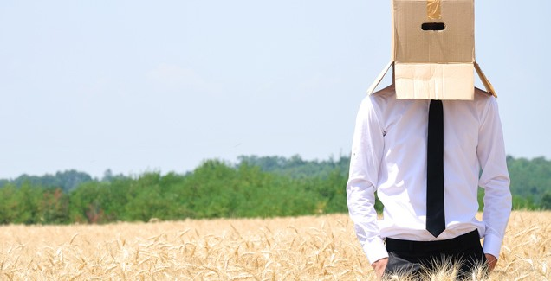
Think outside the box

Slide 20
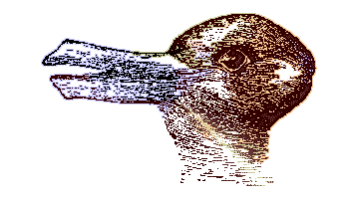
Rabbit or duck?
Notes:
1434-1435

Slide 21
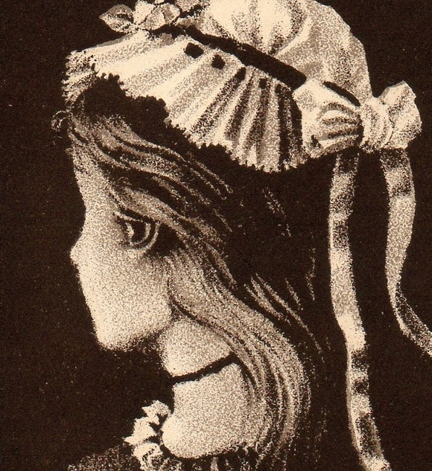
Girl or old lady?
Notes:
1435-1437

Slide 22
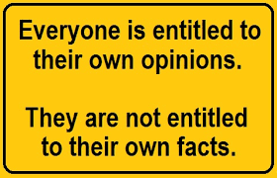
Notes:
1438

Slide 23
Opinion
Fact
Evidence
Definition

Slide 24
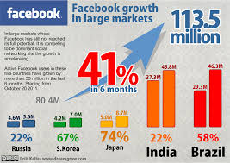
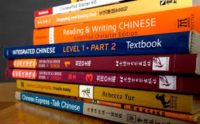
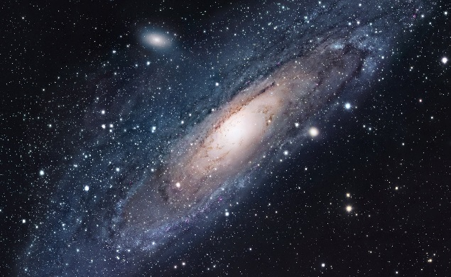
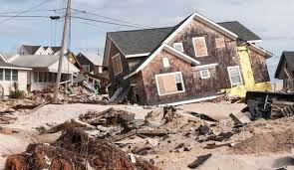
figures
studies
exist
happened
Facts
Notes:
1438-1440

Slide 25
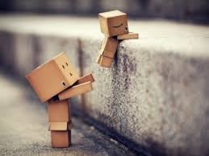
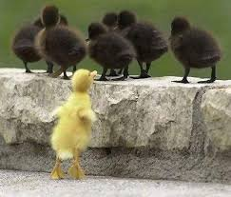


frequency
labeling
belief
attitude
opinions
Notes:
1440-1442

Slide 26
Definition
Standard definition
Operational definition
Fact
opinion
Notes:
1442-1443

Slide 27
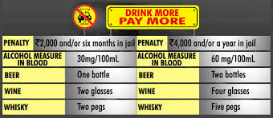
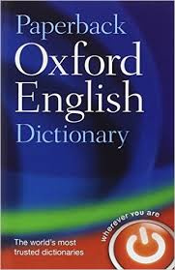
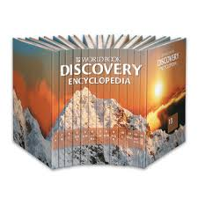
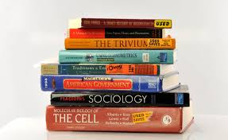
Government regulations/ laws
Encyclopedia
Standard definition
dictionary
textbooks
Notes:
1443-1445

Slide 28
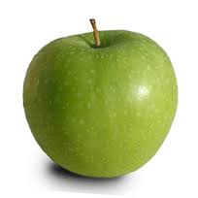
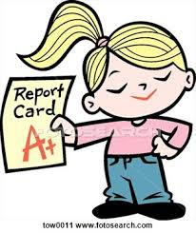
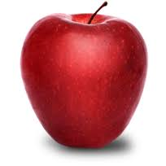
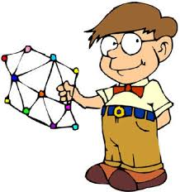
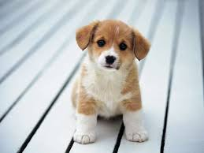
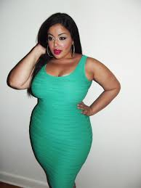
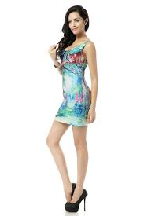
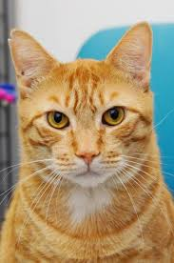
Operational definition
interpretation
Notes:
1445-1447

Slide 29
No statistics and no time. It is OPINION.
Drunk driving is responsible for the recent three months of death accidents.
The law penalizes persons for operating a vehicle with a BAC (blood alcohol concentration) of .05.
(Taiwan, traffic regulation)
Standard definition
Notes:
1447-49

Slide 30
No statistics and no time. It is OPINION.
Drunk driving is responsible for the recent three months of death accidents.
Persons who are operating a vehicle are affected by alcohol, which causes a slow physical reaction to proceeding along, or dodging pedestrians or barriers on the road.
---- Mick Lin
Operational definition
Notes:
1449-1451

Slide 31
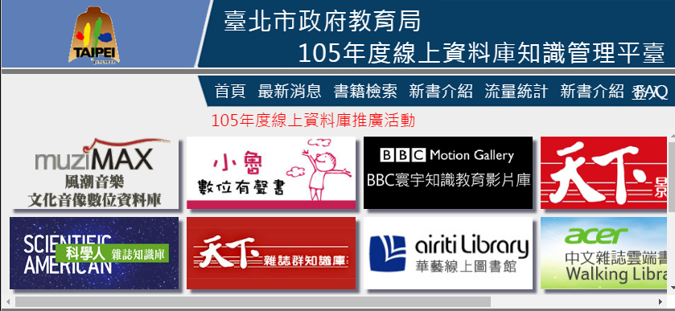
Notes:
1451-1453

Slide 32
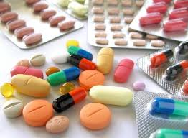
What and where is the proof?
(A) Why do you believe/not believe that?
(B) How do you know it is/is not true?
(C) Can you prove it?
(D) What is the proof?
(C) Where is the evidence?
Notes:
1453-1455

Slide 33
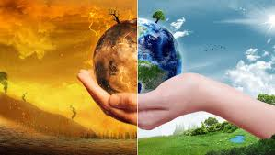
Facts
research
source
Notes:
1455-57

Slide 34

People are giving their own opinions
A system thinker will collect different opinions and try to find the shared vision.
Notes:
1500

Slide 35
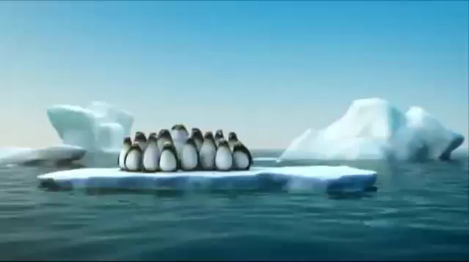
Shared Vision
Notes:
1500-1502 clip
1502-1512 ORI (What scenes do you see? What sounds do you hear? What makes you feel nervous? What is surprising to you? What can you associate the clip with your life? What have your learned in the clip?)

Slide 36
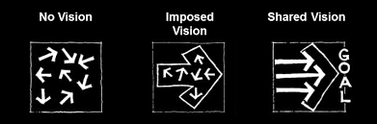
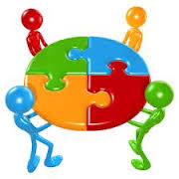
You and the other members want to create or accomplish as part of the organization, and it is not imposed by one or a few people as an organizational mandate.
Notes:
1512-1514

Slide 37
Iceberg Theory

Slide 38
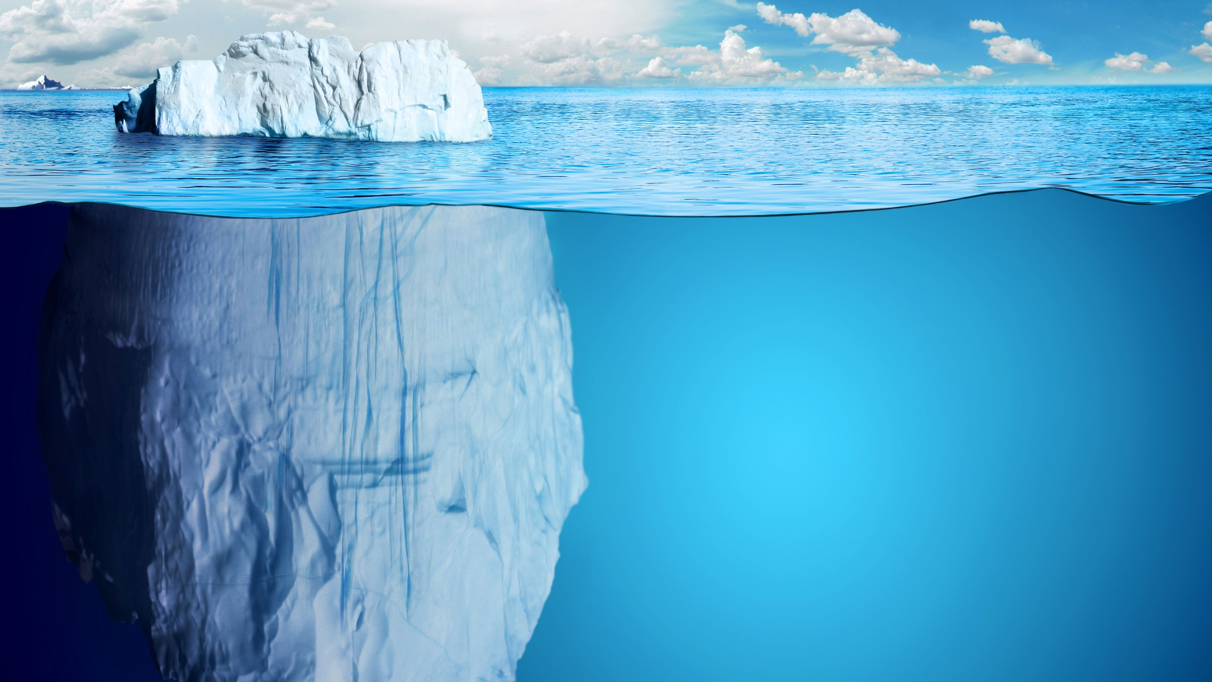
A great amount of iceberg is hidden underwater.
Notes:
1514-1515

Slide 39
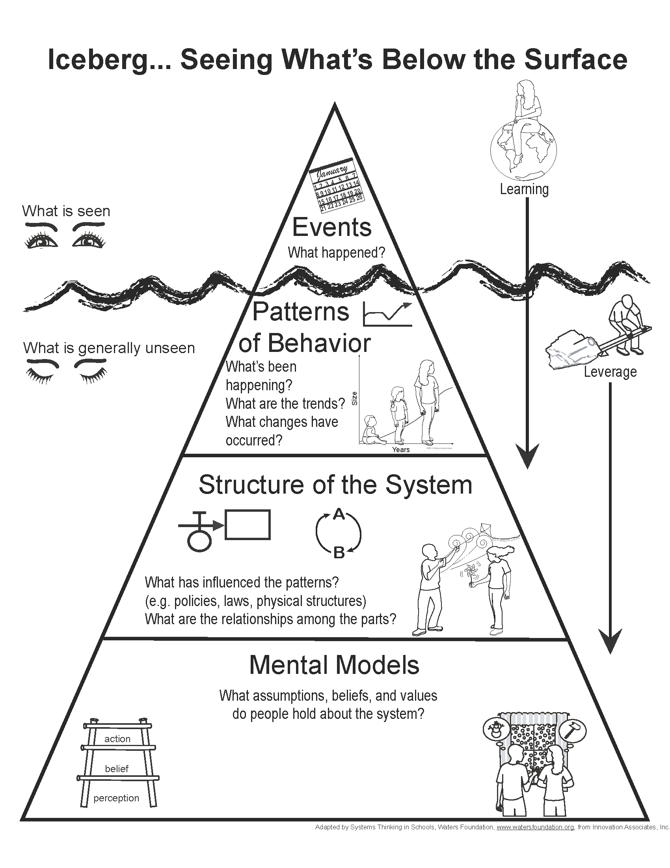
Notes:
1515-1525 ORI (What do you see? Which part make you curious? What is the iceberg like? Which one do you think counts the most?)

Slide 40
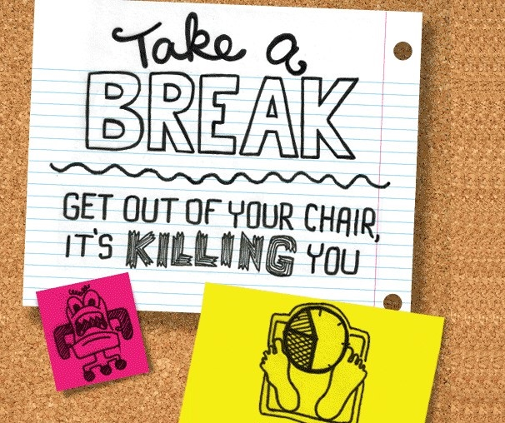
10 mins
Notes:
1525-1535

Slide 41
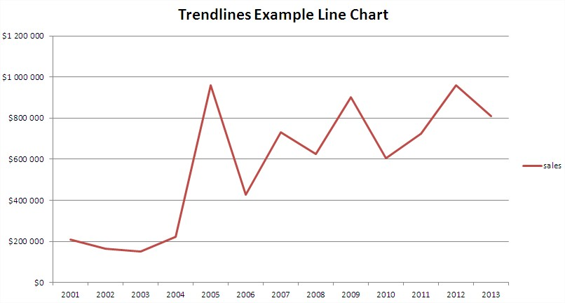
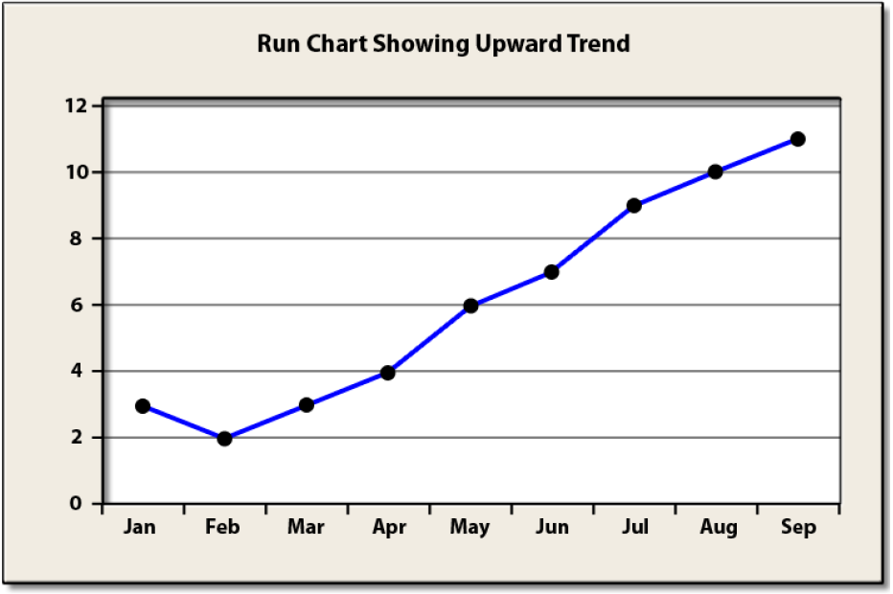
Patterns of Behaviors
Notes:
1535-1540 ( a long-term repeated behavior)

Slide 42

Structure of the system
Notes:
1540-43 Clip
1543-1548 (What do you see? Which part is interesting to you? Which part is surprising to you? Why do the people look stunned / scared/ or sad? What can we do to jump to the conclusion too quickly?)

Slide 43
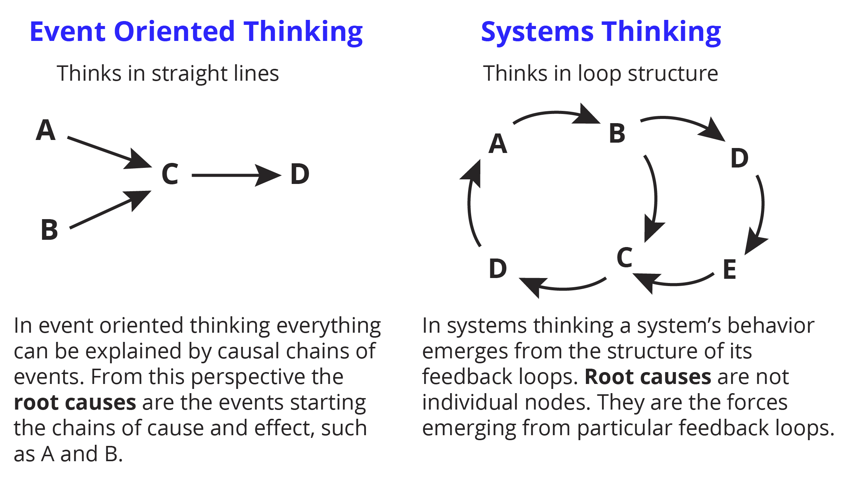
Notes:
1548-1550

Slide 44
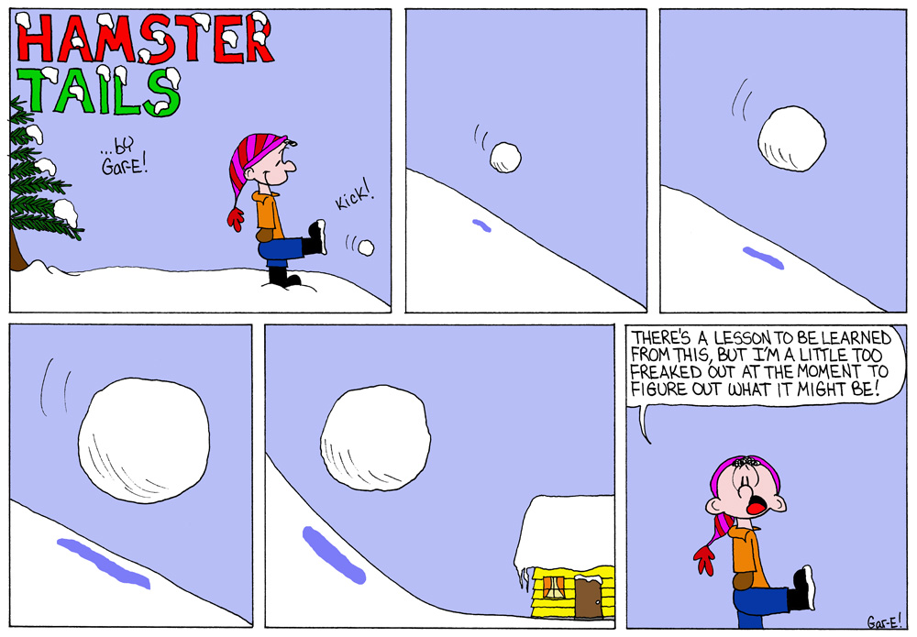
Two Types of Loop
Reinforcing Loop (think of a snowball)
Balancing Loop (think of the air-con)
Delay
Notes:
1550-52

Slide 45
+/-
Reinforcing Loop
A increases
A decreases
B increases
B decreases
+/-
Notes:
1552-54

Slide 46
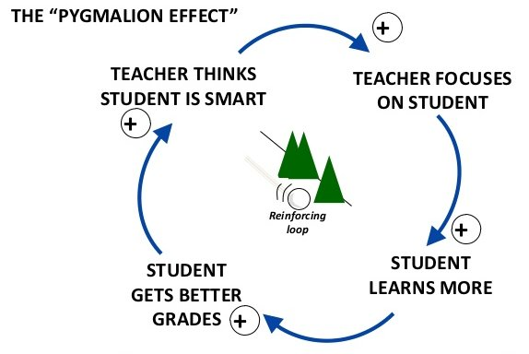
Notes:
1554-56

Slide 47
Expected result
Go upward
Time
Notes:
1557

Slide 48
Expected result
Go downward
Time
Notes:
1558

Slide 49
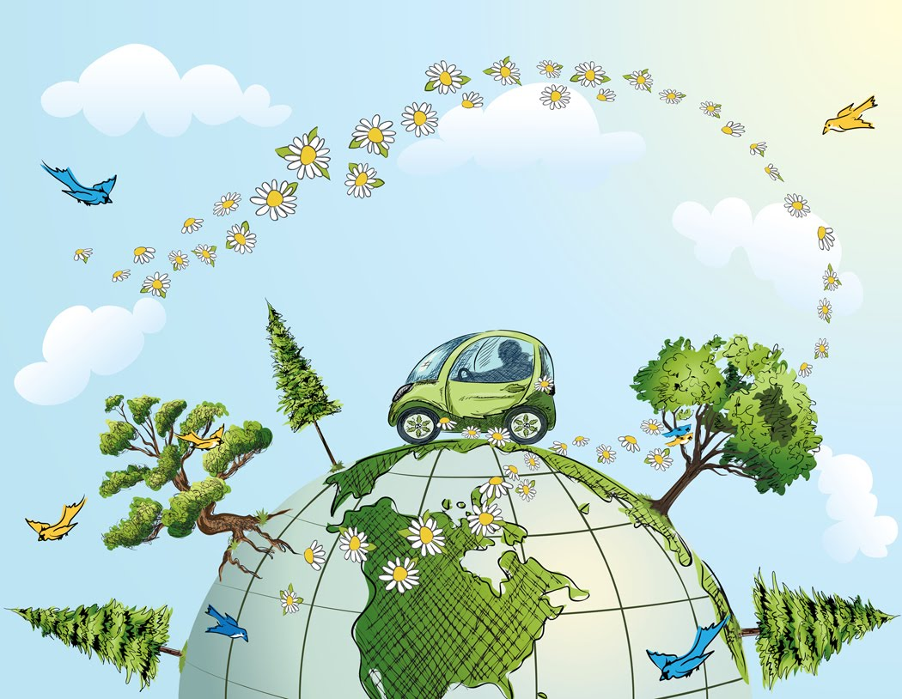
Let’s talk about reinforcing loop in our daily life
Notes:
1558-1603 (2 mins for discussion and 3 mins for sharing)

Slide 50
1.二氧化碳排放量越多，全球溫度增加
2.股票下跌，賣股票的人增加
3.廢水排放量越多，水汙染越嚴重
4.網路霸凌造成憂鬱症患者增加

Slide 51
My Class…
The less financial support ….
The more CO2 is released ….
The more oil is consumed….
As we spend on social websites….
With the birth rate declining….
Notes:
1603-1605

Slide 52
-
+
Balancing
Loop
C
B
B
R
A
-
+
Notes:
1605-1607

Slide 53
調節環路
系統在一個條件變化時，系統會作出抵抗該變化的行為。
調節環路是尋求穩定的系統，自然界中有許多這樣的系統。
若這個穩定系統與組織（甚或個體）所追求的目標是相同的話，調節環路是個助力，反之就會成為阻力。
調節環路提供穩定平衡的作用！
師大教育系林子斌副教授

Slide 54
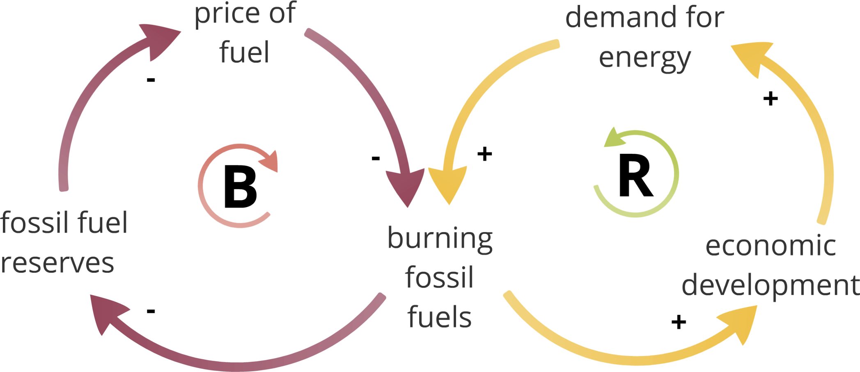
Notes:
0607-1609

Slide 55
Expected result
Go upward
The real situation is not a straight line.
Time
Notes:
1609-1610

Slide 56
Result
The real situation is a curve line.
Time
Notes:
1609-0612

Slide 57
老師出許多功課給學生，但學生成績未因此變好
農夫噴灑農藥以清除害蟲，但是銷售量反而下降
遊覽車司機超時工作，午夜開車撞上高速公路護欄
為了減肥不吃正餐，但是零食消耗量隨之增加，體重也增加

Slide 58
Let’s talk about balancing loop in our daily life
Notes:
1612-1617 (2 mins for discussion and 3 mins for sharing)

Slide 59
My Class…
I have taken the medicine for three days, but…
Although I set the conditioner at 26℃…
No matter how hard the government has tried to promote recycling…
Though a lot of trees have been planted each year…
Notes:
1617-1620

Slide 60
Time Delay
Actual condition
Time delay
Corrective action
Notes:
1620-1622

Slide 61
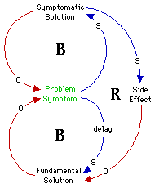
Drinking
Working pressure
Liver
disease
Time delay
Regular
exercise
Notes:
1622-1625

Slide 62
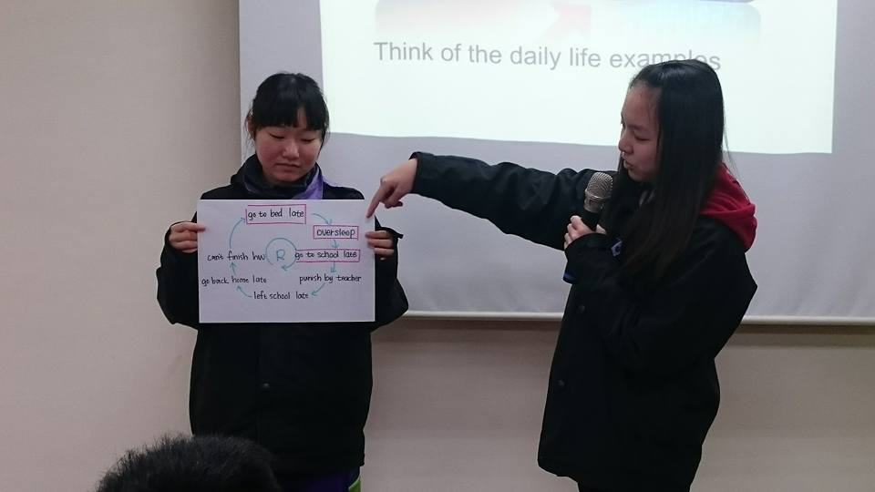

Slide 63


Slide 64

Notes:
1627

Slide 65




Mental Model
Mental models are deeply ingrained assumptions, generalizations, or even pictures of images that influence how we understand the world and how we take action.
Notes:
1627-1629

Slide 66
Story
Spikey
Buffy
Simba
Norma
Snuggle
Notes:
1629-1634

Slide 67
Most hated
Least hated
 | 5 | 4 | 3 | 2 | 1
Spikey | 8 | 3 | 6 | 0 | 1
Buffy | 0 | 4 | 6 | 4 | 4
Simba | 7 | 5 | 3 | 3 | 0
Norma | 3 | 4 | 7 | 2 | 2
Snuggle | 0 | 1 | 1 | 8 | 8
Notes:
1634-1640

Slide 68

Let’s talk about the characters!

Slide 69

Do you perceive your mental model?
Notes:
1642

Slide 70

High
Leverage
Notes:
1642-1644

Slide 71
下圖呈現的是美國某高中的全體學生每天進行各種活動的時間分配，請寫一篇至少120個單詞的英文作文。
文分兩段，第一段描述該圖所呈現之特別現象；第二段請說明整體而言，你一天的時間分配與該高中全體學生的異同，並說明其理由。
Notes:
1644

Slide 72

What can you see in the chart
What has/have been happening over time
The causes of the differences
The different mental models contributing to the differences
The way to transform the fixed mindset
Notes:
1644-1647

Slide 73

Take Fair Trade for Example

Slide 74

If you want to promote fair trade in your community, what are your concerns?
Notes:
1647-1650

Slide 75

farmer
Wholesaler
consumer
retailer
What position did you take when you spoke out your concerns?
humanitarian
government
Notes:
1650-1652

Slide 76
Fair Trade
farmers
gangsters
officials
Manuf-acturers
The relationships between components
Notes:
1652-1655

Slide 77

The 11 Laws of the Fifth Discipline

Slide 78

Today’s problems come from yesterday’s ‘solutions’.
今日的問題源自昨日的解決之道

Slide 79

The harder you push, the harder the system pushes back.
愈用力推，系統反彈力量愈大（皮球效應）

Slide 80

Behavior will grow better before it grows worse.
情況變糟之前會先變好

Slide 81

The easy way out usually leads back in.
顯而易見的解往往無效

Slide 82

The cure can be worse than disease.
解決之道可能比問題更糟

Slide 83

Faster is slower.
欲速則不達

Slide 84

Cause and effect are not closely related in time and space.
因與果在時空上並不緊密相連

Slide 85

Small changes can produce big results.
魔鬼藏在細節裡

Slide 86

You can have your cake and eat it too- but not all at once.
魚與熊掌可以兼得

Slide 87

Dividing an elephant in half does not produce two small elephants.
不可分割的整體性

Slide 88

There is no blame.
沒有絕對的內外（不怨天尤人）

Slide 89
The end

